Slide 1

Water Jug Problem
We are given two jugs, a 4-gallon one and 3-gallon one. Neither has any measuring marked on it. There is a pump, which can be used to fill the jugs with water. How can we get exactly 2 gallons of water into 4-gallon jug?
The state space for this problem can be described as the set of ordered pairs of integers (X, Y) such that X = 0, 1, 2, 3 or 4 and Y = 0, 1, 2 or 3; X is the number of gallons of water in the 4-gallon jug and Y the quantity of water in the 3-gallon jug.
The start state is (0, 0) and the goal state is (2, n) for any value of n, as the problem does not specify how many gallons need to be filled in the 3-gallon jug (0, 1, 2, 3). So the problem has one initial state and many goal states.
Alka Singh AI Unit 03

Slide 2
In order to describe the operators completely here are some assumptions, not mentioned, in the problem state.
1. We can fill a jug from the pump.
2. We can pour water out a jug, onto the ground
3. We can pour water out of one jug into the other.
4. No other measuring devices are available.
All such additional assumptions need to be given when converting a problem statement in English to a formal representation of the problem, suitable for use by a program.
There are several sequences of operators which will solve the problem, two such sequences are shown in Fig below
Alka Singh AI Unit 03

Slide 3
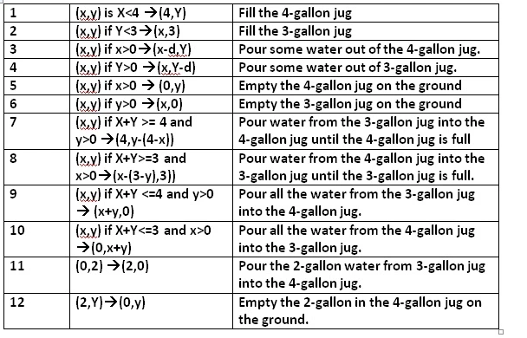
Alka Singh AI Unit 03

Slide 4
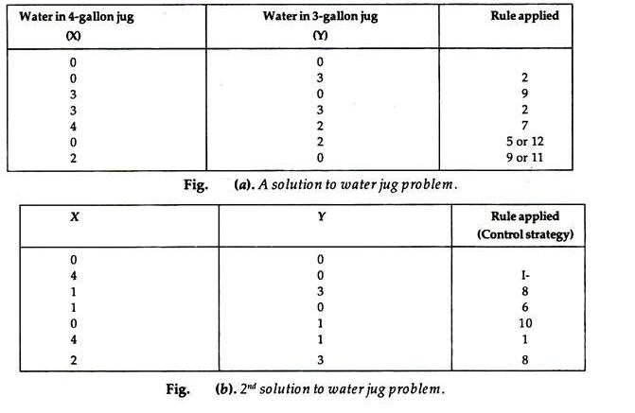
Alka Singh AI Unit 03

Slide 5
Missionaries-cannibals problem
Question: In this problem, three missionaries and three cannibals must cross a river using a boat which can carry at most two people, under the constraint that, for both banks, that the missionaries present on the bank cannot be outnumbered by cannibals. The boat cannot cross the river by itself with no people on boat.
Solution:
First let us consider that both the missionaries (M) and cannibals(C) are on the same side of the river.
Left Right
Initially the positions are : 0M , 0C and 3M , 3C (B)
Now let’s send 2 Cannibals to left of bank : 0M , 2C (B) and 3M , 1C
Send one cannibal from left to right : 0M , 1C and 3M , 2C (B)
Now send the 2 remaining Cannibals to left : 0M , 3C (B) and 3M , 0C
Send 1 cannibal to the right : 0M , 2C and 3M , 1C (B)
Alka Singh AI Unit 03

Slide 6
Now send 2 missionaries to the left : 2M , 2C (B) and 1M , 1C
Send 1 missionary and 1 cannibal to right : 1M , 1C and 2M , 2C (B)
Send 2 missionaries to left : 3M , 1C (B) and 0M , 2C
Send 1 cannibal to right : 3M , 0C and 0M , 3C (B)
Send 2 cannibals to left : 3M , 2C (B) and 0M , 1C
Send 1 cannibal to right : 3M , 1C and 0M , 2C (B)
Send 2 cannibals to left : 3M , 3C (B) and 0M , 0C
• Here (B) shows the position of the boat after the action is performed.
Therefore all the missionaries and cannibals have crossed the river safely.
Alka Singh AI Unit 03

Slide 7
Monkey and Banana Problem
Problem Statement
Suppose the problem is as given below −
A hungry monkey is in a room, and he is near the door.
The monkey is on the floor.
Bananas have been hung from the center of the ceiling of the room.
There is a block (or chair) present in the room near the window.
The monkey wants the banana, but cannot reach it.
Alka Singh AI Unit 03

Slide 8
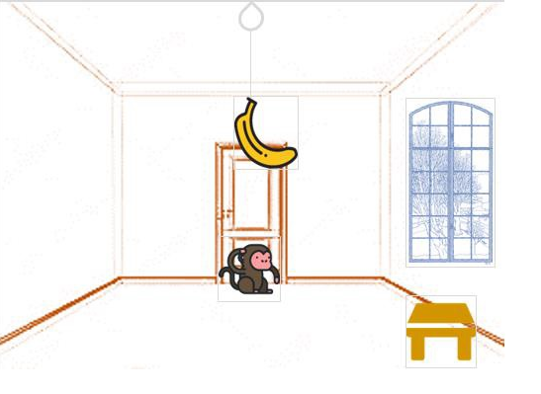
Pushkal K Shukla AI Unit 02

Slide 9
So how can the monkey get the bananas?
So if the monkey is clever enough, he can come to the block, drag the block to the center, climb on it, and get the banana. Below are few observations in this case −
Monkey can reach the block, if both of them are at the same level. From the above image, we can see that both the monkey and the block are on the floor.
If the block position is not at the center, then monkey can drag it to the center.
If monkey and the block both are on the floor, and block is at the center, then the monkey can climb up on the block. So the vertical position of the monkey will be changed.
When the monkey is on the block, and block is at the center, then the monkey can get the bananas.
Alka Singh AI Unit 03

Slide 10
Now, let us see how we can solve this using Prolog. We will create some predicates as follows −
We have some predicates that will move from one state to another state, by performing action.
When the block is at the middle, and monkey is on top of the block, and monkey does not have the banana (i.e. has not state), then using the grasp action, it will change from has not state to has state.
From the floor, it can move to the top of the block (i.e. on top state), by performing the action climb.
The push or drag operation moves the block from one place to another.
Monkey can move from one place to another using walk or move clauses.
Alka Singh AI Unit 03

Slide 11
Another predicate will be canget(). Here we pass a state, so this will perform move predicate from one state to another using different actions, then perform canget() on state2. When we have reached to the state ‘has>’, this indicates ‘has banana’.
We will stop the execution.
Alka Singh AI Unit 03

Slide 12
N-Queen Problem
The N Queen is the problem of placing N chess queens on an N×N chessboard so that no two queens attack each other.
For example, the following is a solution for 8 Queen problem.
Alka Singh AI Unit 03

Slide 13
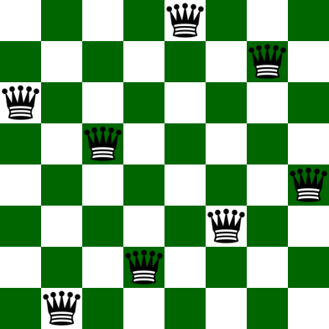
Alka Singh AI Unit 03

Slide 14
Input: N = 4
Output:
0 1 0 0
0 0 0 1
1 0 0 0
0 0 1 0
Explanation:
The Position of queens are:
1 – {1, 2}
2 – {2, 4}
3 – {3, 1}
4 – {4, 3}
As we can see that we have placed all 4 queens
in a way that no two queens are attacking each other.
So, the output is correct
Alka Singh AI Unit 03

Slide 15
Input: N = 8
Output:
0 0 0 0 0 0 1 0
0 1 0 0 0 0 0 0
0 0 0 0 0 1 0 0
0 0 1 0 0 0 0 0
1 0 0 0 0 0 0 0
0 0 0 1 0 0 0 0
0 0 0 0 0 0 0 1
0 0 0 0 1 0 0 0
Alka Singh AI Unit 03

Slide 16
While there are algorithms like Backtracking to solve N Queen problem, let’s take an AI approach in solving the problem.
It’s obvious that AI does not guarantee a globally correct solution all the time but it has quite a good success rate of about 97% which is not bad.
A description of the notions of all terminologies used in the problem will be given and are as follows:
Notion of a State – A state here in this context is any configuration of the N queens on the N X N board. Also, in order to reduce the search space let’s add an additional constraint that there can only be a single queen in a particular column. A state in the program is implemented using an array of length N, such that if state[i]=j then there is a queen at column index i and row index j.
Alka Singh AI Unit 03

Slide 17
Notion of Neighbours – Neighbours of a state are other states with board configuration that differ from the current state’s board configuration with respect to the position of only a single queen. This queen that differs a state from its neighbour may be displaced anywhere in the same column.
Optimisation function or Objective function – We know that local search is an optimization algorithm that searches the local space to optimize a function that takes the state as input and gives some value as an output. The value of the objective function of a state here in this context is the number of pairs of queens attacking each other. Our goal here is to find a state with the minimum objective value. This function has a maximum value of NC2 and a minimum value of 0.
Alka Singh AI Unit 03

Slide 18
Algorithm:
Start with a random state(i.e, a random configuration of the board).
Scan through all possible neighbours of the current state and jump to the neighbour with the highest objective value, if found any. If there does not exist, a neighbour, with objective strictly higher than the current state but there exists one with equal then jump to any random neighbour(escaping shoulder and/or local optimum).
Repeat step 2, until a state whose objective is strictly higher than all it’s neighbour’s objectives, is found and then go to step 4.
Alka Singh AI Unit 03

Slide 19
The state thus found after the local search is either the local optimum or the global optimum. There is no way of escaping local optima but adding a random neighbour or a random restart each time a local optimum is encountered increases the chances of achieving global optimum(the solution to our problem).
Output the state and return.
Alka Singh AI Unit 03

Slide 20
It is easily visible that the global optimum in our case is 0 since it is the minimum number of pairs of queens that can attack each other. Also, the random restart has a higher chance of achieving global optimum but we still use random neighbour because our problem of N queens does not has a high number of local optima and random neighbour is faster than random restart.
Conclusion:
  Random Neighbour escapes shoulders but only has a little chance of escaping local optima.
  Random Restart both escapes shoulders and has a high chance of escaping local optima.
Alka Singh AI Unit 03

Slide 21

Alka Singh AI Unit 03

